Slide 1
Software engineering (Undergraduate)
Chapter 10 integration testing
Course Name software quality and testing
CSC 4133
(Undergraduate)

Slide 2
System integration testing
Chapter 10: Integration Testing
MMH
S.2
Large, complex software products can go through several iterations of build-and-test cycles before they are fully integrated
System integration testing (SIT) is a systematic technique for assembling a software system while conducting tests to uncover errors associated with interfacing the modules
The objective is to build a “working” version of the system by:
Putting modules together in an incremental manner after conducting unit testing on module
Ensuring that the additional modules work as expected without disturbing the functionalities of the modules already put together
Integration testing is said to be complete when
The system is fully integrated together
All the test cases have been executed
All the severe and moderate defects found have been fixed

Slide 3
System integration testing
Chapter 10: Integration Testing
MMH
S.3
Advantages of System Integration Testing
Defects are detected early, It is easier to fix defects detected earlier
Get earlier feedback on the acceptability of the individual modules and on the overall system
Scheduling of defect fixes is flexible, and it can overlap with development process
“If all the unit-tested modules work individually, why can these modules not work when put together?”
The problem arises when we “put modules together” because of interface errors
Interface errors are those that are associated with structures existing outside the local environment of a module, but which the module uses

Slide 4
Types of interfaces
Chapter 10: Integration Testing
MMH
S.4
Procedure call interface (function call):
A procedure in one module calls a procedure in another module. The caller passes on control to the called module. The caller can pass data to the called procedure, and the called procedure can pass data to the caller while returning control back to the caller.
Shared memory interface (global variable):
A block of memory is shared between two modules. The memory block may be allocated by one of the two modules or a third module. Data are written into the memory block by one module and are read from the block by the other.
Message passing interface (interaction):
One module prepares a message by initializing the fields of a data structure and sending the message to another module. This form of module interaction is common in client-server-based systems and web-based systems.

Slide 5
Modularity of SIT
Chapter 10: Integration Testing
MMH
S.5
Integration testing includes both white-box and black-box testing approaches.
Various levels of granularities in SIT are :
Intra-system testing
constitutes low-level integration testing with the objective of combining the modules together to build a cohesive system
Inter-system testing
a high-level testing phase which requires interfacing independently tested systems
Pair-wise testing
only two interconnected systems in an overall system are tested at a time.
The purpose is to ensure that two systems under consideration can function together, assuming that the other systems within the overall environment behave as expected

Slide 6
System Integration Techniques: Incremental Integration
Chapter 10: Integration Testing
MMH
S.6
Integration testing is conducted in an incremental manner as a series of test cycles
In each test cycle, a few more modules are integrated with an existing and tested to generate a larger build
Key idea is to complete one cycle of testing, let the developers fix all the defects found, and continue the next cycle of testing.
Advantages:
The incremental approach has the advantage that the defects are found early in a smaller assembly when it is relatively easy to detect the cause.
Disadvantages:
A disadvantage is that it can be time-consuming since stubs and drivers have to be developed and used in the test.

Slide 7
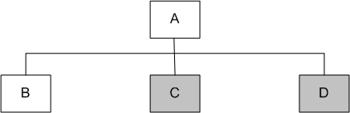
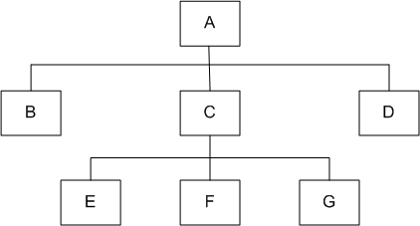
System Integration Techniques: Top-down integration
Chapter 10: Integration Testing
MMH
S.7
Fig.1
Module A has been decomposed into modules B, C, and D
Modules B, D, E, F, G are terminal modules (fig.2)
First integrate modules A and B using stubs C and D (represented by grey boxes)
Next stub D has been replaced with its actual instance D
Two kinds of tests are performed:
Test the interface between A and D
Regression tests to look for interface defects between A and B in the presence of module D
Fig.2

Slide 8
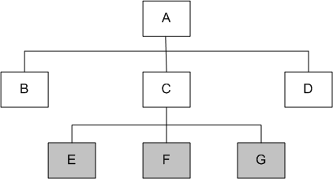
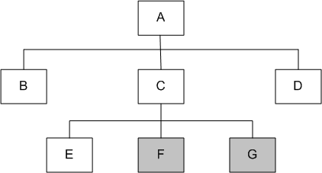
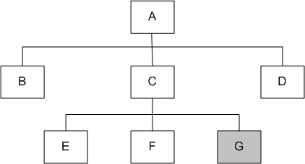
System Integration Techniques: Top-down integration
Chapter 10: Integration Testing
MMH
S.8
Fig1: Top-down integration of modules A, B, D and C
Fig2: Top-down integration of modules A, B, C, D and E
Fig3: Top-down integration of modules A, B, C, D, E and F
Stub C has been replaced with the actual module C, and new stubs E, F, and G
Perform tests as follows:
first, test the interface between A and C;
second, test the combined modules A, B, and D in the presence of C

Slide 9
System Integration Techniques: Top-down integration
Chapter 10: Integration Testing
MMH
S.9
Advantages
SIT engineers continually observe system-level functions as the integration process continues
Isolation of interface errors becomes easier because of the incremental nature of the top-down integration
Test cases designed to test the integration of a module M are reused during the regression tests performed after integrating other modules
Disadvantages
Basic functionality is tested at the end of cycle
It may not be possible to observe meaningful system functions because of an absence of lower level modules and the presence of stubs.
Test case selection and stub design become increasingly difficult when stubs lie far away from the top-level module.

Slide 10
System Integration Techniques: bottom-up integration
Chapter 10: Integration Testing
S.10
MMH
System integration begins with the integration of lowest level modules
A module is said to be at the lowest level if it does not invoke another module
It is assumed that all the modules have been individually tested before
To integrate a set of lower level modules, need to construct a test driver module that invokes the modules to be integrated
Once the integration of a desired group of lower level modules is found to be satisfactory, the driver is replaced with the actual module and one more test driver is used to integrate more modules with the set of modules already integrated.
The process of bottom-up integration continues until all the modules have been integrated
Advisable when the project is unique in nature

Slide 11
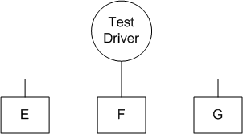
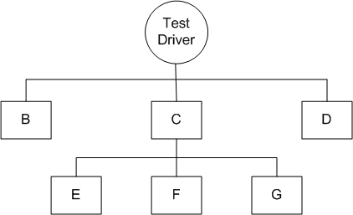
System Integration Techniques: bottom-up integration
Chapter 10: Integration Testing
S.11
MMH
Fig 2: Bottom-up integration of module B, C, and D with F, F, and G
Fig 1: Bottom-up integration of module E, F, and G
We design a test driver to integrate lowest-level modules E, F, and G
The test driver simulates module C to integrate E, F, and G in a limited way.
The test driver (C) is replaced with actual module
A new test driver is used for more modules such as B and D are integrated
The new test driver mimics the behavior of module A, finally
The test driver is replaced with module A and further test are performed after the testers are satisfied

Slide 12
System Integration Techniques: bottom-up integration
Chapter 10: Integration Testing
S.12
MMH
Advantages
If the low-level modules and their combined functions are often invoked by other modules, then it is more useful to test them first so that meaningful effective integration of other modules can be done (useful when the project is novel)
Disadvantages
Discovery of major flaws in system design may not be possible until the top-level modules have been integrated
Test engineers can not observe system-level functions from a partly integrated system
We can catch the Key interface defects at the end of cycle

Slide 13
System Integration Techniques: big bang
Chapter 10: Integration Testing
S.13
MMH
First all the modules are individually tested. Next, all those modules are put together to construct the entire system which is tested as a whole
Sometimes developers use this approach for integrating small systems. However, for large systems, this approach is not recommended
Advantage
Big Bang testing has the advantage that everything is finished before integration testing starts
Disadvantages
The major disadvantage is that in general it is time consuming and difficult to trace the cause of failures because of this late integration

Slide 14
System Integration Techniques: sandwich
Chapter 10: Integration Testing
S.14
MMH
A system is integrated by using a mix of top-down, bottom-up, and big-bang approaches
A hierarchical system is viewed as consisting of three layers
The bottom-up approach is applied to integrate the modules in the bottom-layer
The top layer modules are integrated by using top-down approach
The middle layer is integrated by using the big-bang approach after the top and the bottom layers have been integrated

Slide 15
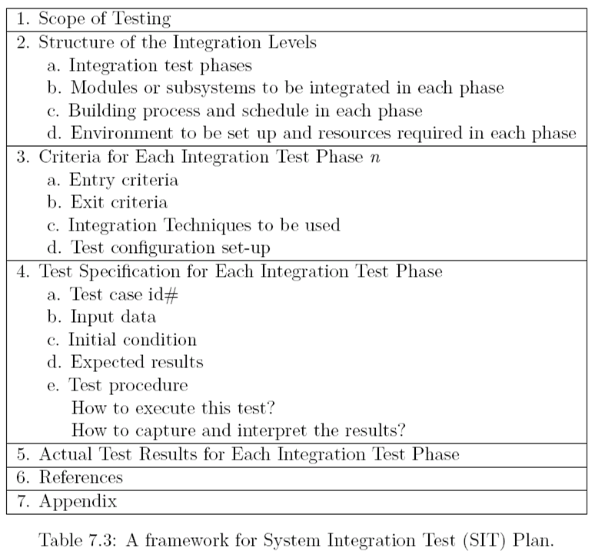
Test plan for System integration
Chapter 10: Integration Testing
S.15
MMH
System integration requires a controlled execution environment, much communication between the developers & the test engineers.
Integrating a large system is a challenging task, which is handled with much planning in the form of developing a SIT plan.
A useful framework for preparing an SIT plan can be used.

Slide 16
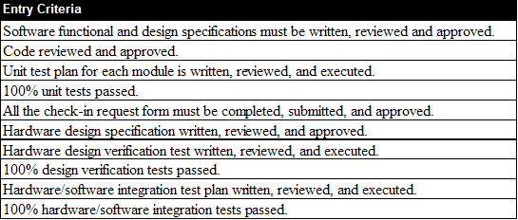
Test plan for System integration
Chapter 10: Integration Testing
S.16
MMH

Slide 17
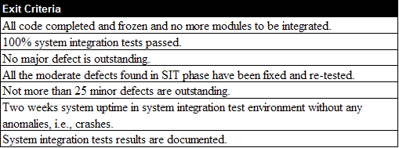
Test plan for System integration
Chapter 10: Integration Testing
S.17
MMH

Slide 18
Categories of System Integration Test
Chapter 10: Integration Testing
S.18
MMH
Interface integrity: internal and external interfaces are tested as each module is integrated
Functional validity: test are designed to uncover functional errors in each module after it is integrated with the system.
End-to-end validity: tests are performed to ensure that a completely integrated system works together from end-to-end.
Pair-wise validity: tests are performed to ensure that any two systems work properly when connected together by a network
Interface stress: tests are performed to ensure that the interfaces can sustain the load
System endurance: tests are performed to ensure that the integrated system stay up for weeks without any crashes

Slide 19
Off-the-self component Integration
Chapter 10: Integration Testing
S.19
MMH
Instead of developing a software component from scratch, organizations occasionally purchase off-the-self (OTS) components from third-party vendors and integrate them with their own components.
OTS components produced by the vendor organizations are known as commercial off-the-shelf (COTS) components.
Advantages of COTS component integration
Less time consuming
Lest costly
More reliable

Slide 20
Off-the-self component Integration
Chapter 10: Integration Testing
S.20
MMH
Challenges of COTS component integration
A major issue that can arise while integrating different components is mismatches among code pieces developed by different parties usually unaware of each other.
Integration not always trivial; incompatibilities among vendors
The buyer has no access to the source code
Dependence on vendor – the vendor controls it development
Stability of the vendor –vendors can go out of business, can be purchased by other companies or completely drop support for a product

Slide 21
Off-the-shelf component testing
Chapter 10: Integration Testing
S.21
MMH
Black-box component testing
used to determine the quality of the component
System-level fault injection testing
used to determine how well a system will tolerate a failing OTS component
Operational system testing
used to determine the tolerance of a software system when the OTS component is functioning correctly. Operational system test is conducted to ensure that an OTS component is a good match for the system.

Slide 22
references
Chapter 10: Integration Testing
S.22
MMH
Software Testing And Quality Assurance – Theory and Practice - Kshirasagar Naik & Priyadarshi Tripathy
Software Quality Engineering: Testing, Quality Assurance and Quantifiable Improvement - Jeff Tian

